Slide 1
CS 5187: Vision and Image
Lecture 2-1
Image Sampling and Resizing
Dr. Dapeng Oliver Wu
City University of Hong Kong
Department of Computer Science
Semester A, 2026/27

Slide 2
Lecture Outline
Introduction
Nyquist sampling (decomposition) and interpolation theorem (reconstruction)
  Similar to Fourier transform, wavelet transform?
Common sampling and interpolation filters
Sampling rate conversion of discrete images

Slide 3

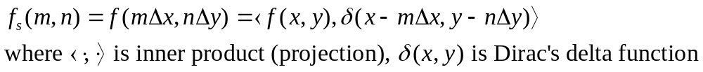
Uniform Sampling
f(x,y) represents the original continuous image, f_{s}(m,n) the sampled image, and the reconstructed image.
Uniform sampling (orthonormal decomposition)
  Δx and Δy are vertical and horizontal sampling intervals. f_{s,x}=1/Δx, f_{s,y}=1/ Δy are vertical and horizontal sampling frequencies.
  Similar to Fourier transform, wavelet transform?

Slide 4
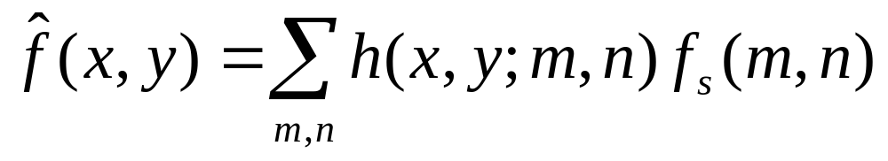
Reconstruction from Discrete Samples
Interpolation (synthesis, reconstruction)
  The value of a function at arbitrary point (x, y) is estimated from a weighted sum of its sample values in the neighborhood of ([x/Δx], [y/Δy]):
  Similar to Fourier transform, wavelet transform
  In general, the interpolation function h(x,y;m,n) is spatial invariant, and depends only on distance between (x,y) and the spatial location of (m,n), e.g.

Slide 5
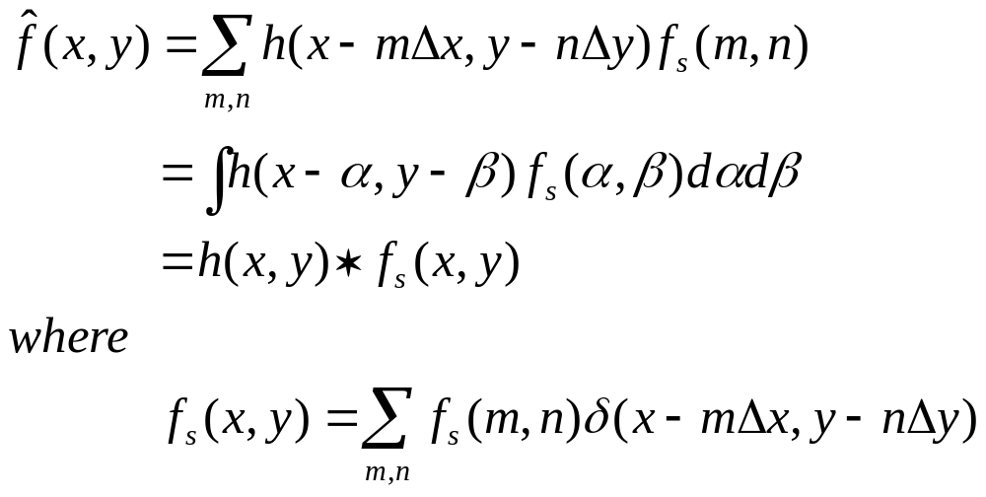
Reconstruction from Discrete Samples
The interpolation process
  Can be accomplished by a linear convolution
  h(x,y) specifies the weight used for a sample that is distant from the point
  Usually, h(x,y) is separable h(x,y) = h_{x}(x)h_{y}(y)

Slide 6
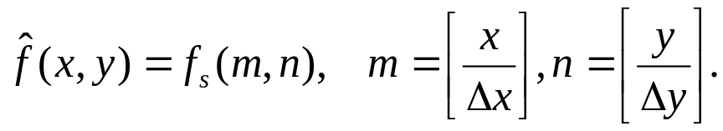
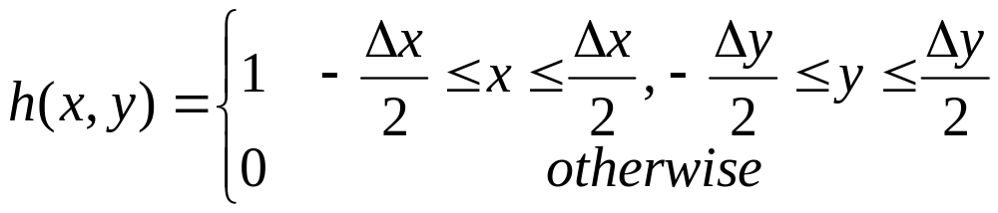
Example: Pixel Replication
Pixel replication or nearest neighbor filter
  The interpolated value at a point is obtained from that of the nearest sample,
  where [x] represents the nearest integer to x.
  Corresponding interpolation filter is

Slide 7
Illustration of Image Sampling and Interpolation
dx=dy=2mm
16 mm
dx=dy=1mm

Slide 8
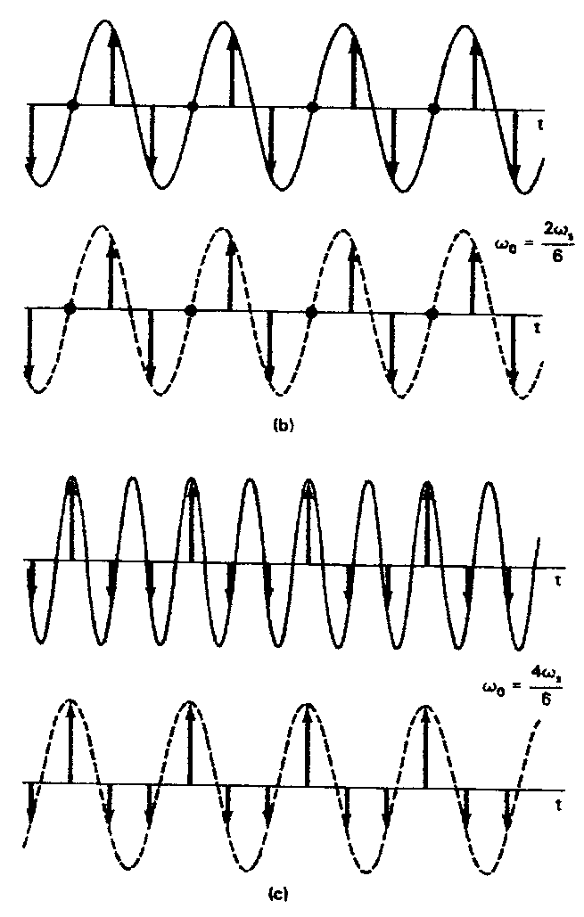
Sampling of 1D Sinusoid Signals
Sampling above
Nyquist rate
ω_{s}=3ω_{m}>ω_{s0}
Reconstructed
=original
Sampling under
Nyquist rate
ω_{s}=1.5ω_{m}<ω_{s0}
Reconstructed
\= original
Aliasing: The reconstructed sinusoid has a lower frequency than the original!

Slide 9
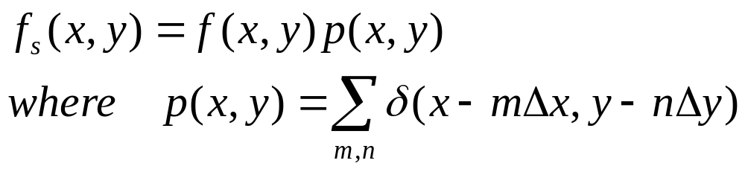
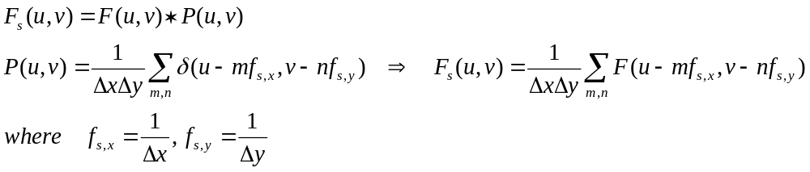
Frequency Domain Interpretation of Sampling
Sampling is equivalent to multiplication of the original signal with a sampling pulse sequence.
In frequency domain

Slide 10
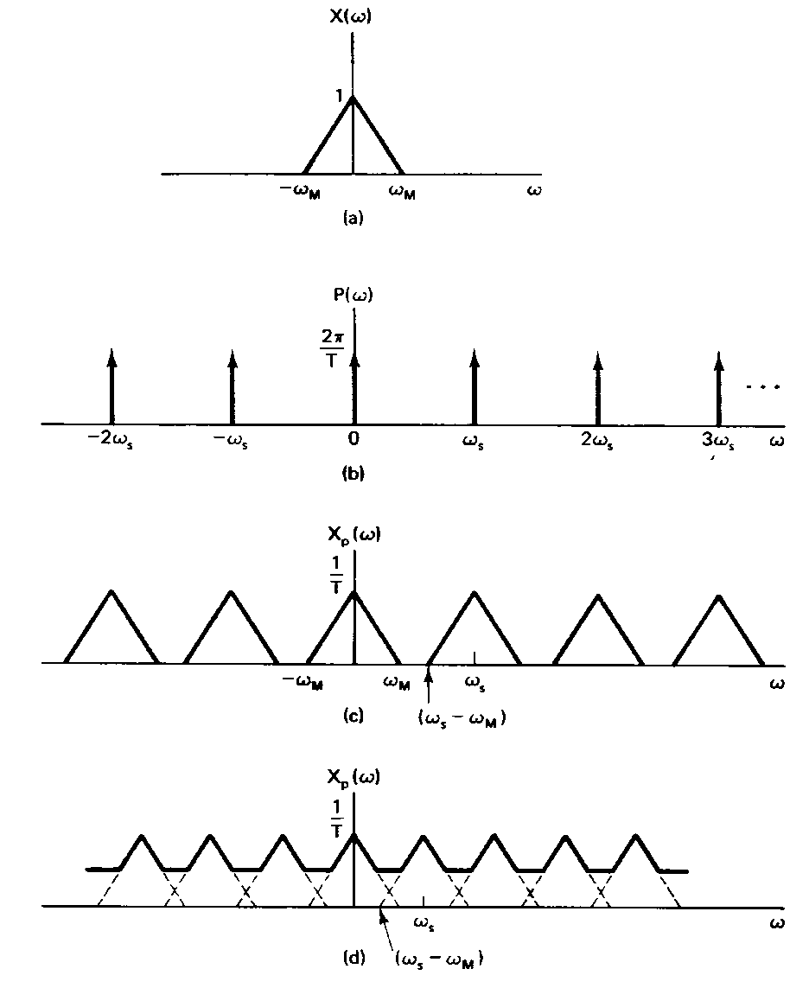
Frequency Domain
Interpretation of Sampling in 1D
What’s the inverse Fourier Transform?
Original signal
The spectrum of the sampled signal includes the original spectrum and its aliases (copies) shifted to k f_{s} , k=+/- 1,2,3,… The reconstructed signal from samples has the frequency components upto f_{s} /2.
When f_{s}< 2f_{m} , aliasing occur.
Sampling
impulse train
Sampled signal
f_{s} > 2f_{m}
Sampled signal
f_{s} < 2f_{m}
(Aliasing effect)

Slide 11
Frequency Domain Interpretation of Sampling in 2D
The sampled signal contains replicas of the original spectrum shifted by multiples of sampling frequencies.
u
f_{s,x}
u
f_{m,x}
f_{s,x}>2f_{m,x}
f_{s,y}>2f_{m,y}
v
f_{m,y}
v
f_{s,y}
Original spectrum F(u,v)
Sampled spectrum F_{s}(u,v)

Slide 12
Illustration of Aliasing Phenomenon
u
u
f_{m,x}
f_{s,x}
f_{s,x}<2f_{m,x}
f_{s,y}<2f_{m,y}
f_{m,y}
v
f_{s,y}
v
Original spectrum F(u,v)
Sampled spectrum F_{s}(u,v)

Slide 13
Frequency Domain Interpretation of Sampling and interpolation
Nyquist sampling rate
  To be able to preserve the original signal in the sampled signals, these aliasing (frequency shift) components should not overlap with the original one. This requires that the sampling frequency f_{s,x}, f_{s,y} must be at least twice of the highest frequency of the signal, known as Nyquist sampling rate.
Interpolation
  Intend to remove all the aliasing components
    Impossible for 1D signal, if f_{s}< Nyquist rate
    How about 2D signal?

Slide 14
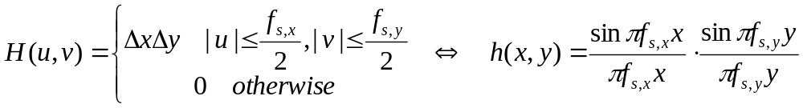
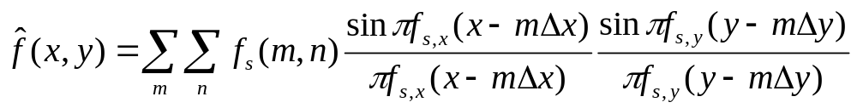
Nyquist Sampling and Reconstruction Theorem
A band-limited image with highest frequencies at f_{m,x}, f_{m,y} can be reconstructed perfectly from its samples, provided that the sampling frequencies satisfy: f_{s,x} ≥2f_{m,x}, f_{s,y}≥2f_{m,y}
The reconstruction can be accomplished by the ideal low-pass filter with cutoff frequency at f_{c,x} = f_{s,x}/2, f_{c,y} = f_{s,y}/2, with magnitude ΔxΔy.
The interpolated image

Slide 15
Applying Nyquist Theorem
Two issues
  The signals are not bandlimited.
    A bandlimiting filter with cutoff frequency f_{c}=f_{s}/2 needs to be applied before sampling. This is called prefilter or sampling filter.
  The sinc filter is not realizable.
    Note that prefilter and interpolator are analog filters.
    Can we use digital filter for prefiltering or interpolation?
A general paradigm
B
D
Prefilter
Interpolation
A
A
Sampling pulse f_{s}

Slide 16
Non-ideal Sampling and Interpolation
Aliased
Component
Pre-filtered
Signal
Aliased
Component
-f_{s}
0
f_{s}
Non-ideal
Interpolation
filter
Aliasing
Imaging

Slide 17
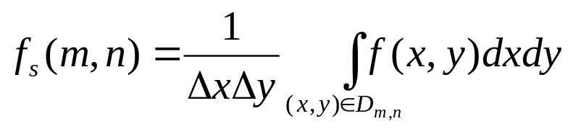
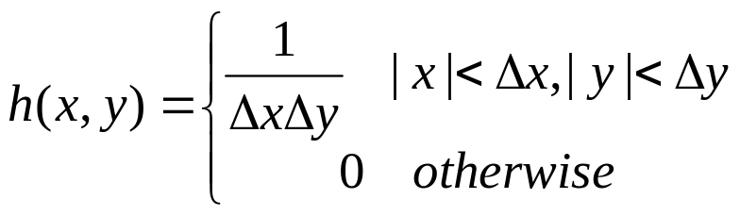
A Simple Sampling Filter – Averaging Filter
Each sampling value is the mean value of the original continuous function in a rectangular region of dimension Δx and Δy, i.e:
n
m
where
The equivalent sampling filter is

Slide 18
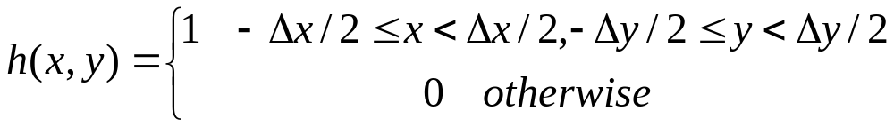
Sample-And-Hold Filter
The interpolated value at a point is obtained from that of its nearest sample
Corresponding interpolation filter is
Reminiscent of vector quantization?
n
0th order interpolation filter
Why? Think of Taylor expansion of a function.
Then what is first order interpolation filter?
(m-1/2)Δx
m
(m+1/2)Δx
(n-1/2)Δy
(n+1/2)Δy

Slide 19
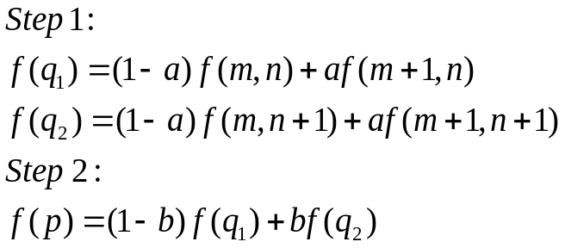

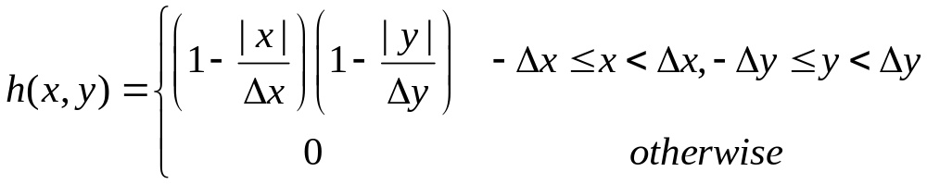
Bilinear Filter
f₁
f_{a}
(m,n)
(m,n+1)
f₀
b
a
0
a
1
q₁
q₂
p
1D Linear interpolation
(m+1,n)
(m+1,n+1)
2D bilinear interpolation
Corresponding interpolation filter

Slide 20
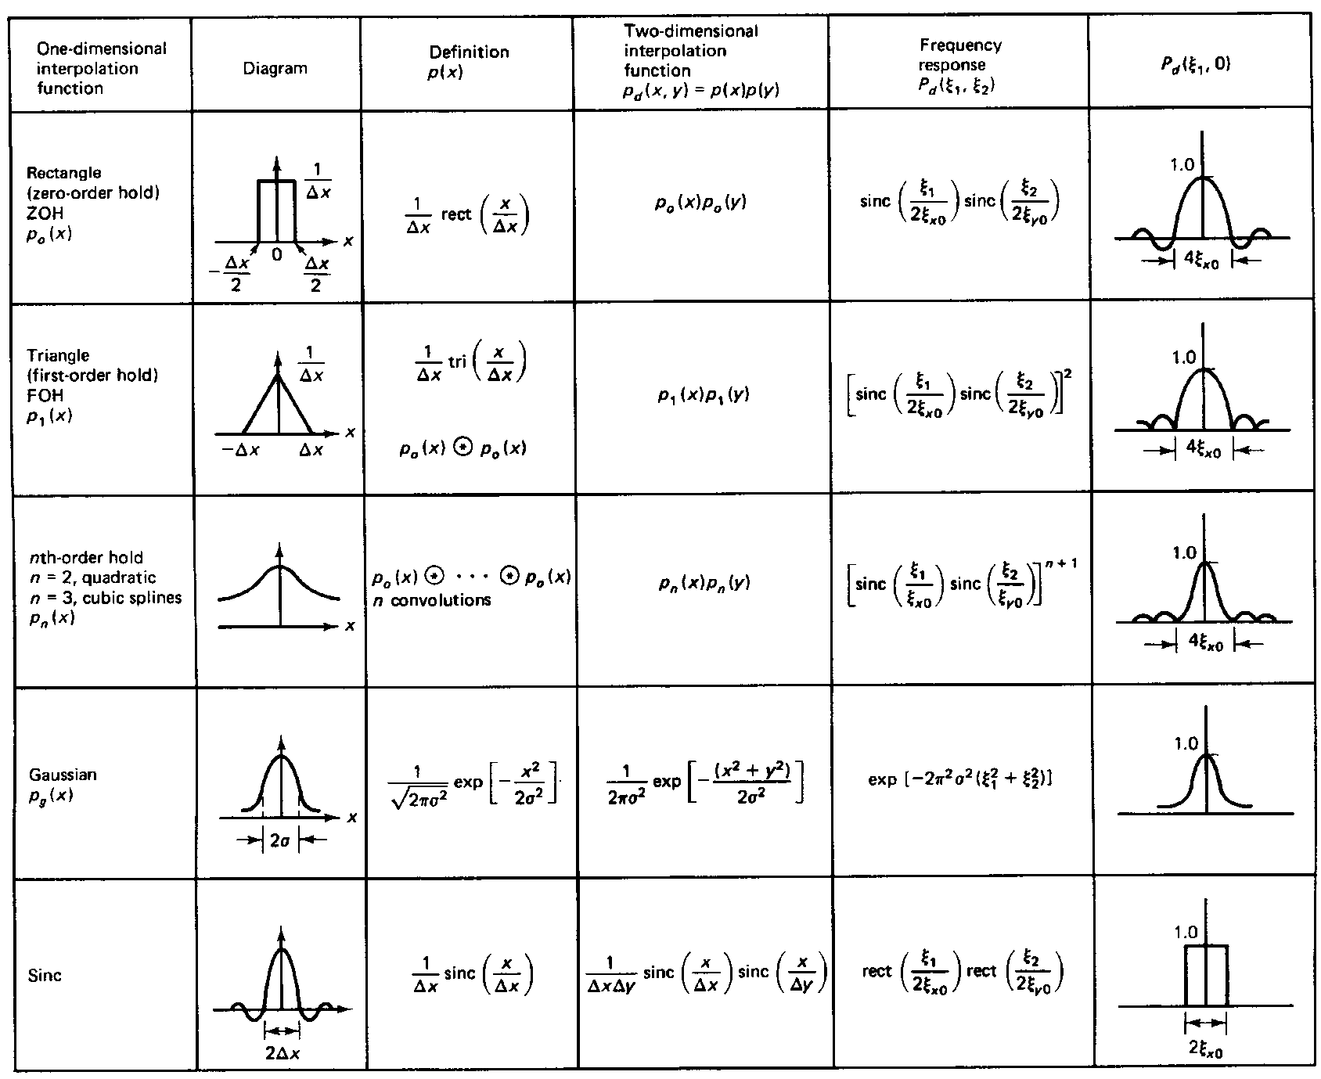
Comparison of Different Interpolation Filters
Absolutely realizable but causes distortion
Absolutely realizable, causes less distortion
Realizable, less distortion, higher complexity as the order increases
Realizable if truncated, less distortion if more concentrated
Perfect reconstruction but not realizable

Slide 21
Image Resizing
Image resizing:
  Enlarge or reduce the image size (number of pixels)
  Equivalent to up-sampling and down-sampling in both horizontal and vertical directions
  A frequent image processing operation
Image down-sampling
  Spatial domain view
  Frequency domain view: need for prefilter
Image up-sampling
  Spatial domain view
  Different interpolation filters
    Nearest neighbor, Bilinear, Bicubic

Slide 22
Image Down-Sampling
Example:
  reduce a 512x512 image to 256x256 = factor of 2 downsampling in both horizontal and vertical directions
  In general, we can down-sample by an arbitrary factor in the horizontal and vertical directions
How should we obtain the smaller image?

Slide 23

Down Sampling by a Factor of Two
Without Pre-filtering (simple approach)
Averaging Filter
8x8 Image
4x4 Image

Slide 24
Problem of Simple Approach
Aliasing if the effective sampling rate is below the Nyquist sample rate = 2 * highest frequency in the signal
We need to prefilter the signal before down-sampling
Ideally the prefilter should be a low-pass filter with a cut-off frequency half of the new sampling rate.
  Prefilter design: trade-off between aliasing and loss of high frequency
In practice, we may use simple averaging filter

Slide 25

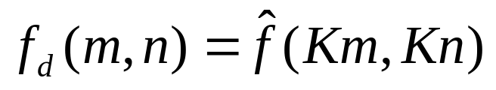
Down Sampling by a Factor of K
f(m,n)
H_{s}
↓K
f_{d}(m,n)
Pre-filtering
Down-sampling

Slide 26



Example: Image Down-Sample
Without prefiltering
With prefiltering

Slide 27
Down-Sampling Using Matlab
Without prefiltering
  If f(,) is an MxN image, down-sampling by a factor of L can be done simply by
    >> g=f(1:L:M,1:L:N)
With prefiltering
  First convolve the image with a desired filter
  Then subsample
    >> fp=conv2(f,h)
    >> g=fp(1:L:M,1:L:N)

Slide 28
Image Up-Sampling
Produce a larger image from a smaller one
  Eg. 512x512 -> 1024x1024
  Can be used in half-pel (H.263 & MPEG-4), or quarter-pel (H.264) motion estimation
Questions:
  How should we generate a larger image?
  Is there a limit on how many times we can enlarge an image?
  Does the enlarged image carry more information?

Slide 29
Example: Factor of 2 Up-Sampling
(m,n)
(m,n+1)
(2m,2n)
(2m,2n+1)
(2m+1,2n)
(2m+1,2n+1)
(m+1,n)
(m+1,n+1)
Blue samples are retained in the interpolated image;
Orange samples are estimated from surrounding green samples.

Slide 30
Nearest Neighbor Interpolation
(m,n)
(m,n+1)
b
a
(
m’/
M,n’/M)
(m+1,n)
(m+1,n+1)
O[m’,n’] (the resized image) takes the value of the sample nearest to (m’/M,n’/M) in I[m,n] (the original image):
Also known as pixel replication: each original pixel is replaced by MxM pixels of the sample value

Slide 31
Special Case: M=2
(m,n)
(m,n+1)
(2m,2n)
(2m,2n+1)
(2m+1,2n)
(2m+1,2n+1)
(m+1,n)
(m+1,n+1)
Nearest Neighbor:
O[2m,2n]=I[m,n]
O[2m,2n+1]= I[m,n]
O[2m+1,2n]= I[m,n]
O[2m+1,2n+1]= I[m,n]

Slide 32
Bilinear Interpolation
(m,n)
(m,n+1)
b
a
(
m’/
M,n’/M)
(m+1,n)
(m+1,n+1)
O(m’,n’) takes a weighted average of 4 samples nearest to (m’/M,n’/M) in I(m,n).
Direct interpolation: each new sample takes 4 multiplications:
O[m’,n’]=(1-a)*(1-b)*I[m,n]+a*(1-b)*I[m,n+1]+(1-a)*b*I[m+1,n]+a*b*I[m+1,n+1]
Separable interpolation:
  i) interpolate along each row y: F[m,n’]=(1-a)*I[m,n]+a*I[m,n+1]
  ii) interpolate along each column x’: O[m’,n’]=(1-b)*F[m’,n]+b*F[m’+1,n]

Slide 33
Special Case: M=2
(m,n)
(m,n+1)
(2m,2n)
(2m,2n+1)
(2m+1,2n)
(2m+1,2n+1)
(m+1,n)
(m+1,n+1)
Bilinear Interpolation:
O[2m,2n]=I[m,n]
O[2m,2n+1]=(I[m,n]+I[m,n+1])/2
O[2m+1,2n]=(I[m,n]+I[m+1,n])/2
O[2m+1,2n+1]=(I[m,n]+I[m,n+1]+I[m+1,n]+I[m+1,n+1])/4

Slide 34


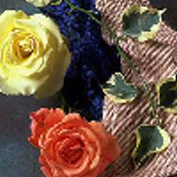
Up-Sampling w/o Post-filtering
Nearest
neighbor
Original
Bilinear
Bicubic

Slide 35



Up-Sampling with Post-filtering
Nearest
neighbor
Original
Bilinear
Bicubic

Slide 36

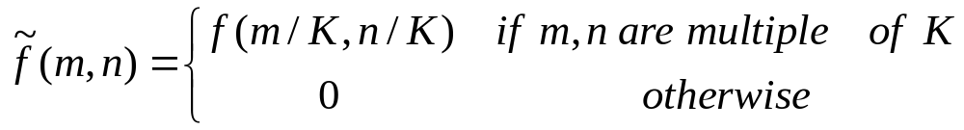
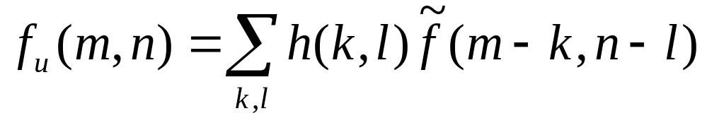
Up Sampling by a Factor of K
f(m,n)
↑K
H_{i}
f_{u}(m,n)
Zero-padding
Post-filtering

Slide 37
Matlab for Image Resizing
[img]=imread('fruit.jpg','jpg');
%downsampling without prefiltering
img1=imresize(img,0.5,'nearest');
%upsampling with different filters:
img2rep=imresize(img1,2,'nearest');
img2lin=imresize(img1,2,'bilinear');
img2cubic=imresize(img1,2,'bicubic');
%down sampling with filtering
img1=imresize(img,0.5,'bilinear',11);
%upsampling with different filters
img2rep=imresize(img1,2,'nearest');
img2lin=imresize(img1,2,'bilinear');
img2cubic=imresize(img1,2,'bicubic');

